Slide 2

Arial OS

Slide 3
Arial OS

Slide 4
Arial OS

Slide 6


Dan
Arial OS
To Begin, Click your user name
Turn off computer
After you log on, you can add or change Accounts.
Just go to Control Panel and click User Accounts

Slide 7

Welcome
Dan
Applying your User settings…
Arial OS
To Begin, Click your user name
Turn off computer
After you log on, you can add or change Accounts.
Just go to Control Panel and click User Accounts

Slide 8


Slide 9


Recycle Bin
Start
3:59 PM

Slide 10
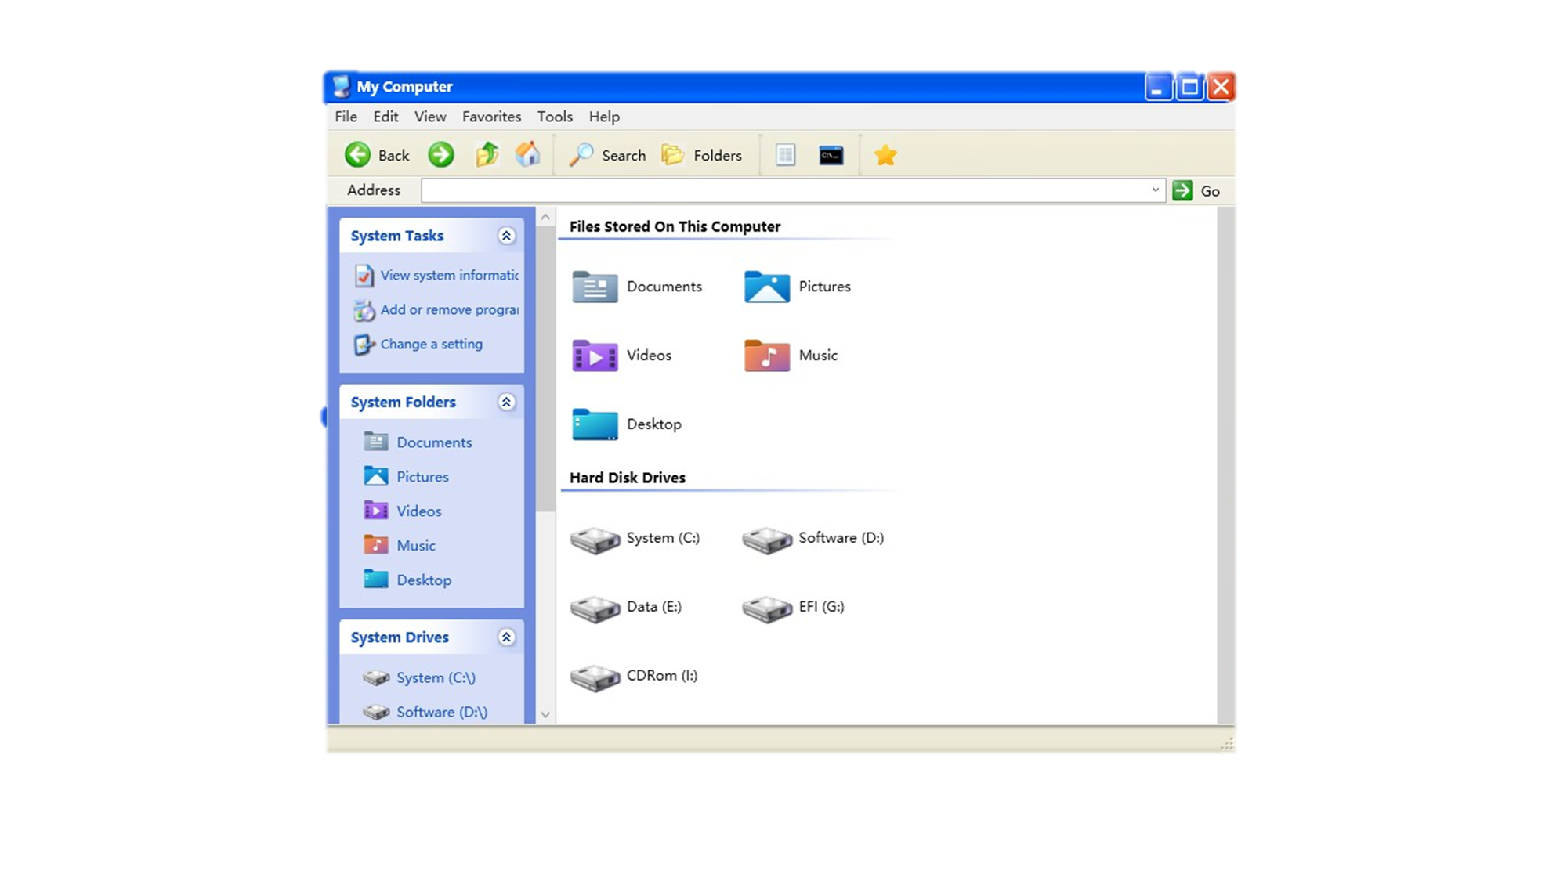
Recycle Bin
Recycle Bin
Start
Recycle Bin
4:00 PM

Slide 11
Recycle Bin
Start
Recycle Bin
4:00 PM

Slide 12
Recycle Bin
Start
Recycle Bin
4:00 PM

Slide 13

















Dan
My Documents
My Recent Documents
My Pictures
My Music
My Computer
Control Panel
Set Program Access and
Defaults
Printers and Faxes
Help and Support
Search
Run
Log off
Turn off computer
Recycle Bin
Start
4:26 PM

Slide 14

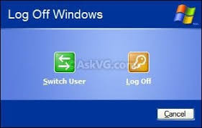


Recycle Bin
Start
4:00 PM

Slide 15
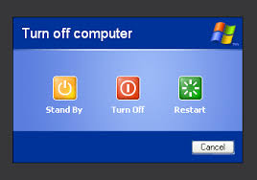
Recycle Bin
Start
4:00 PM

Slide 16
Welcome
Dan
Logging off…

Slide 17
Dan
Arial OS
To Begin, Click your user name
Turn off computer
After you log on, you can add or change Accounts.
Just go to Control Panel and click User Accounts

Slide 18
Welcome
Dan
Logging off…

Slide 19
Welcome
Dan
Arial is now Shutting down…

Slide 20
Arial OS
It is now safe to press Esc

Slide 21
Welcome
Dan
Logging off…

Slide 22
Welcome
Dan
Arial is restarting…

